Slide 1
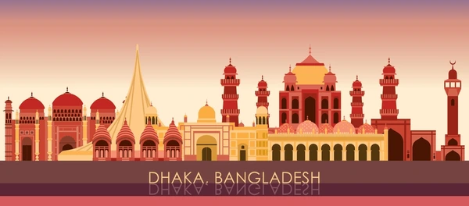
The influence of museums and cultural clubs in creation of our historical and cultural context Preserving our Past, Enriching our Future Group -D Roll: o4,19,24,41,28,08,33

Slide 2
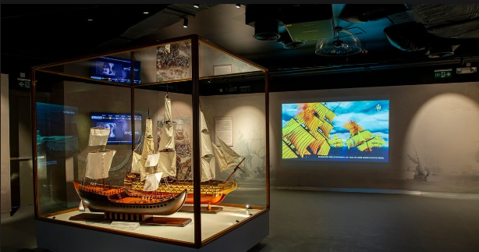
Preface
Museums and cultural clubs serve as custodians of heritage, actively preserving historical artifacts and traditions through meticulous curation and exhibition. They engage in archival efforts, conservation projects, and educational programs to ensure the transmission of cultural knowledge across generations. Through interactive exhibits, workshops, and community events, these institutions foster a sense of connection and appreciation for the rich tapestry of history and tradition embedded within their local communities.

Slide 3
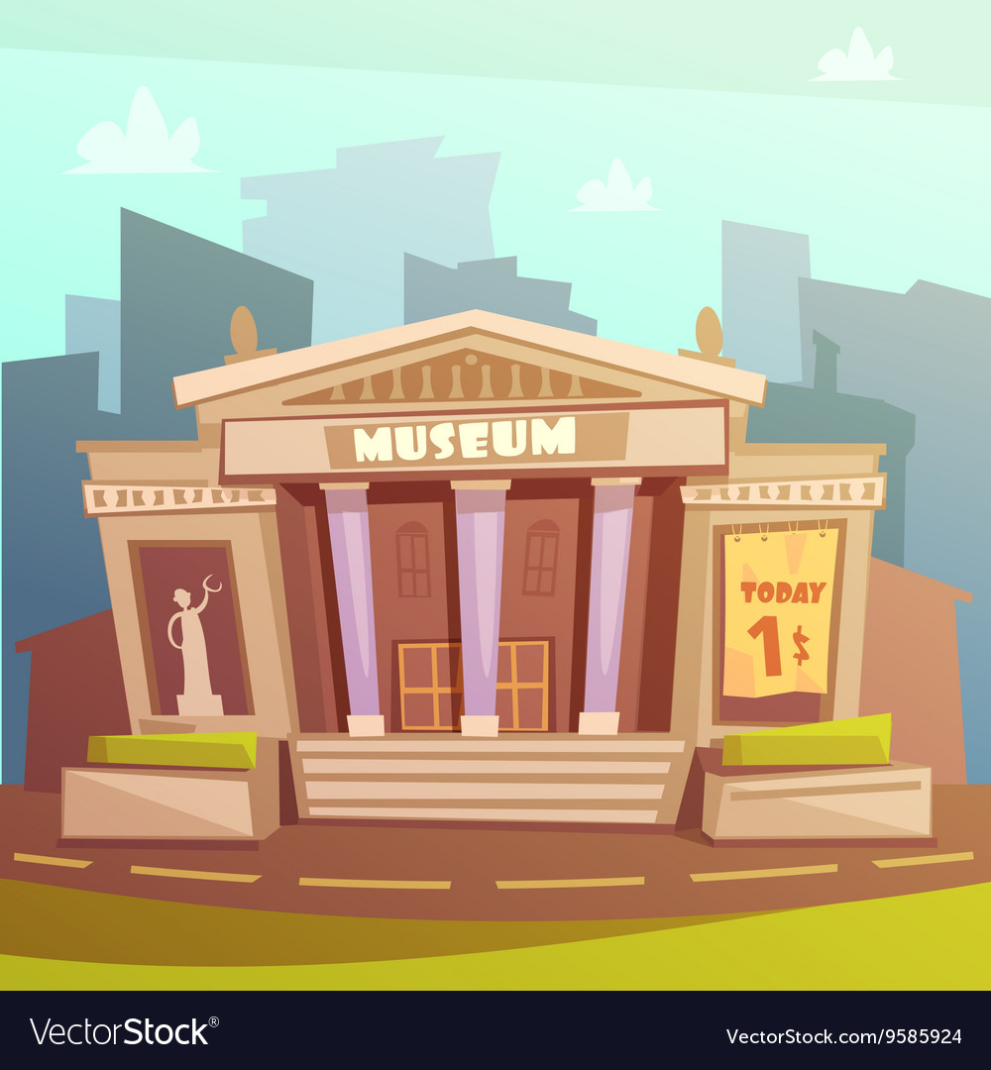
Some significant museums in Bangladesh
-Bangladesh National Museum
-Bangabandhu Military Museum
-Mymensingh Museum
-Sonargaon Museum
-Museum of Tajhat Zamindar in Rangpur
- Ahsan Manjil Museum
-Lalbagh Museum

Slide 4

Examples of some remarkable cultural clubs in Bangladesh
-Chayyanaut Cultural Center (Established in 1961)
-Udichi Shilpgoshthi (Established in 1968)
-Bangladesh Shilpokola Academy (Founded in 1974)
-Shadhona (Founded in 1988)
-Dhaka Club (Established in 1991)

Slide 5
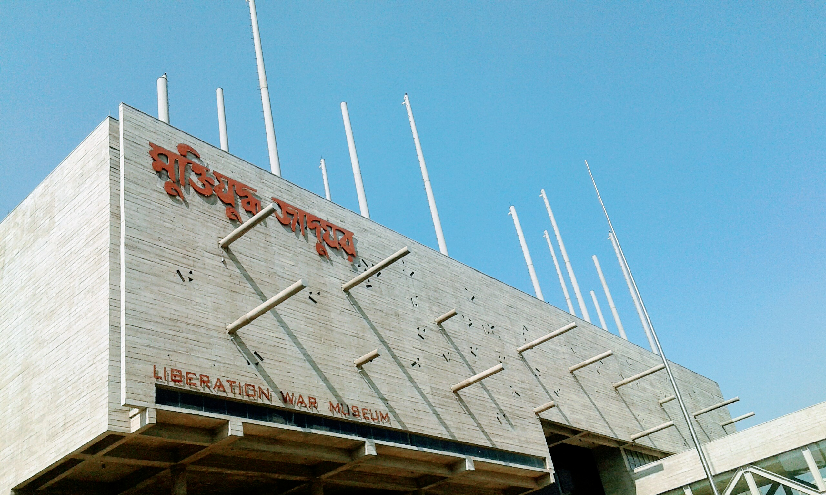
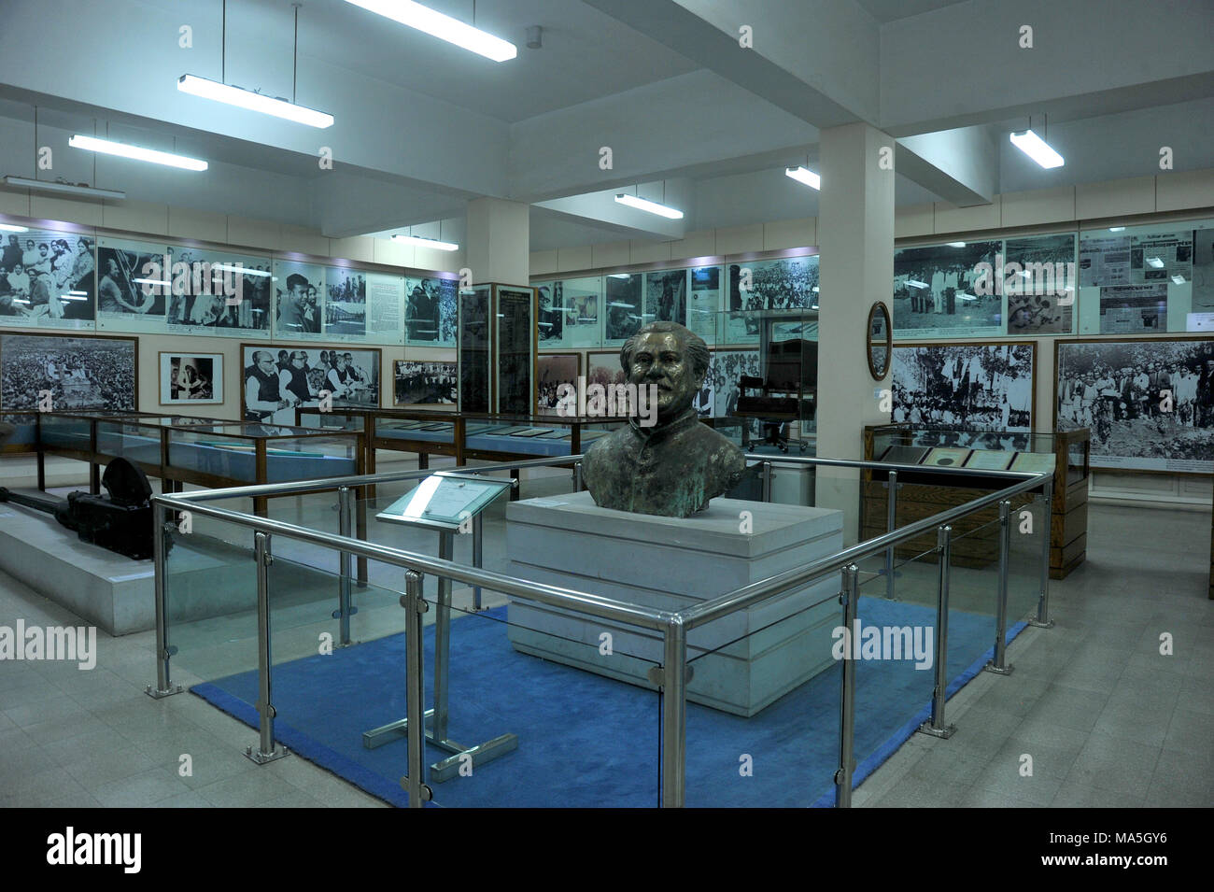
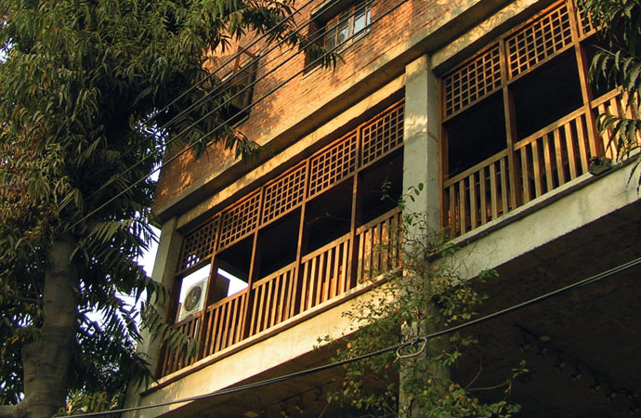
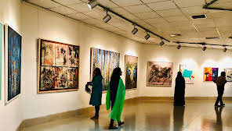
Influence of these institution in our history and culture
In Dhaka, Bangladesh, historical museums and cultural clubs play a pivotal role in preserving the rich heritage of the nation. The Bangladesh National Museum, situated in Shahbag, is a prominent institution housing artifacts spanning millennia, from ancient terracotta sculptures to contemporary artworks. Additionally, cultural clubs like the Dhaka Club and the Chhayanaut Cultural Center serve as vibrant hubs for promoting traditional music, dance, and literature, fostering a deep appreciation for Bangladesh's cultural roots. These establishments not only showcase the country's history and artistic achievements but also actively engage with the community through exhibitions, workshops, and cultural events, ensuring that Bangladesh's heritage continues to thrive and evolve in the heart of its capital city.

Slide 6
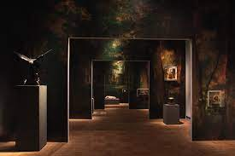
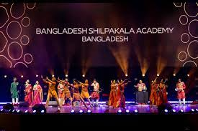
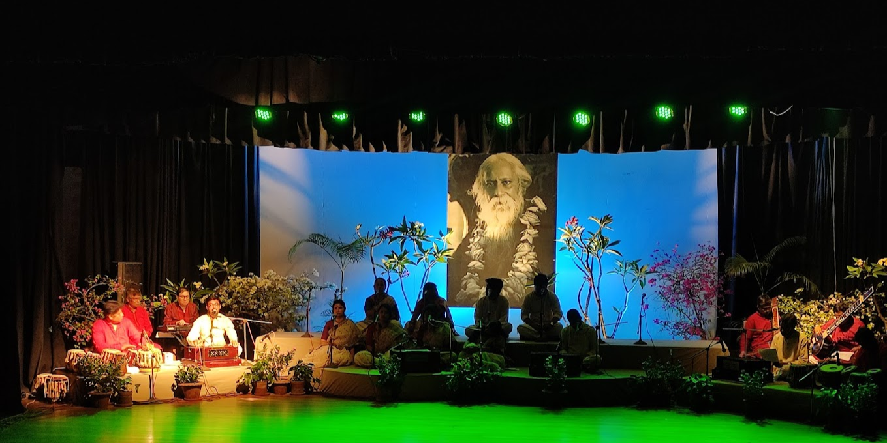
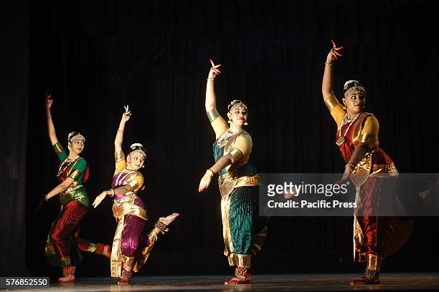
The collaboration of museums and cultural clubs with other institutions to expand their activities all over the country.
These social elements frequently collaborate with community organizations, schools, and cultural ambassadors to reach underserved populations and promote inclusivity. Through interactive exhibits, storytelling sessions, and multicultural events, museums and cultural clubs create dynamic spaces where visitors can explore, question, and connect with the richness of human history and cultural heritage.

Slide 7
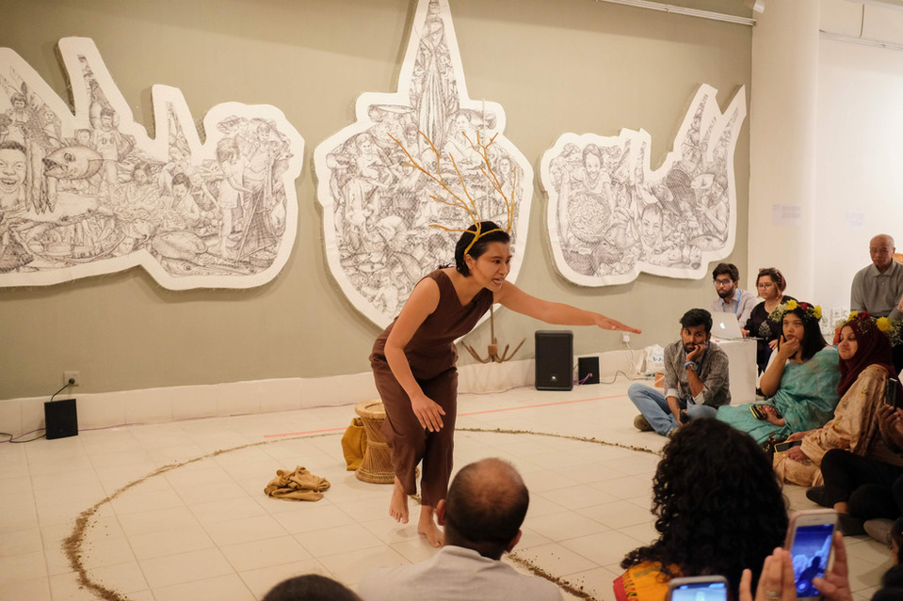
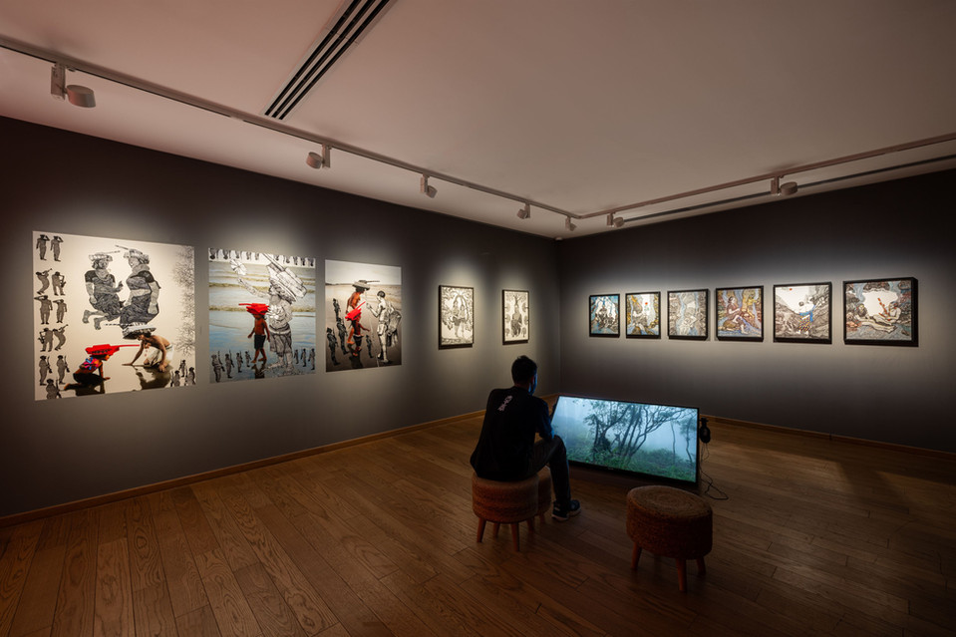
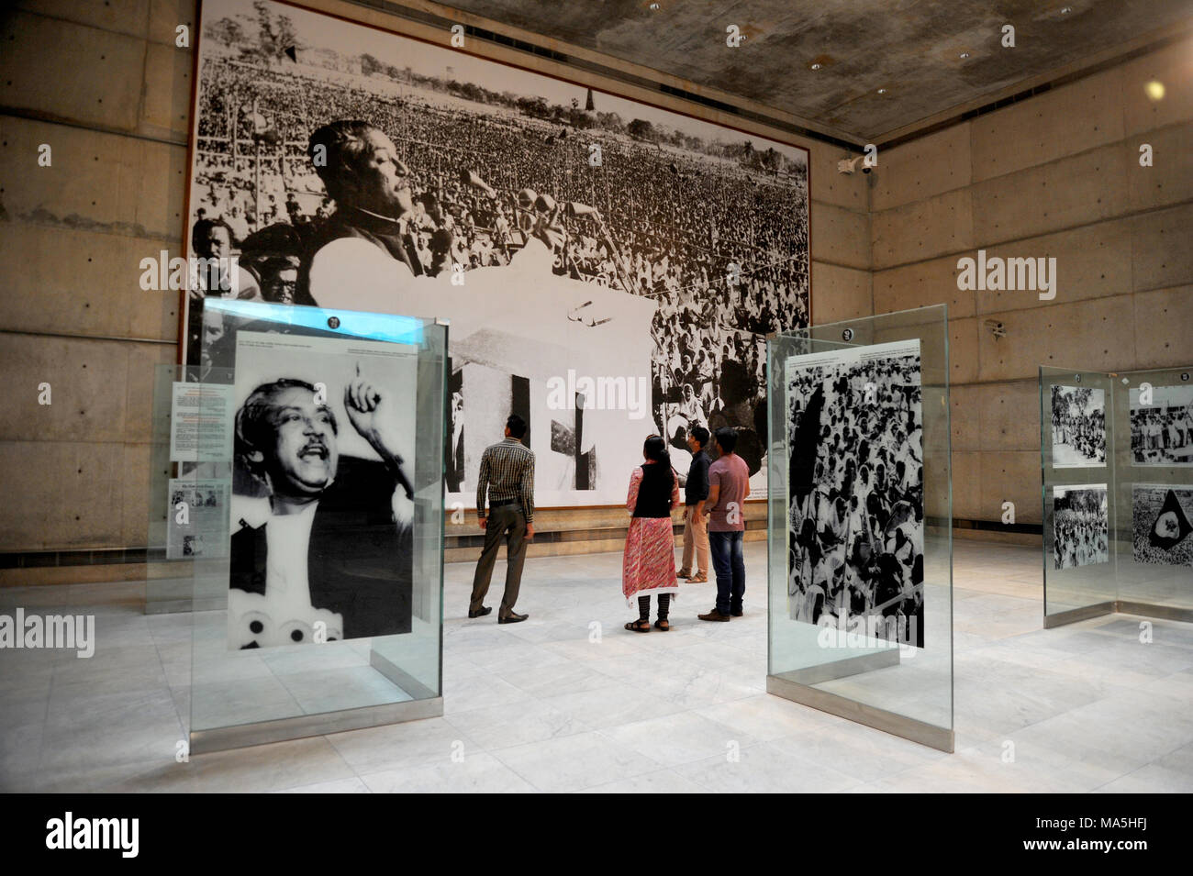
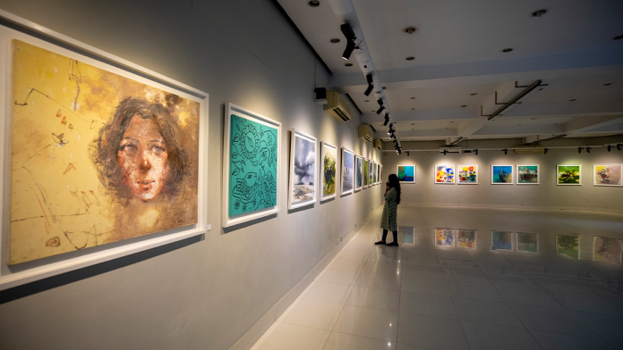
Activities done by museums and cultural clubs in context of Bangladesh
In Bangladesh, cultural groups and museums are important venues for promoting community involvement and a love of culture. To promote traditional arts, crafts, and music to preserve the rich cultural heritage of the country, they arrange educational workshops, exhibitions, and cultural festivals. Furthermore, these organizations frequently work with regional groups and foreign partners to present Bangladeshi culture internationally, fostering understanding and communication between different cultures. Cultural clubs and museums play an important role in promoting and conserving Bangladesh's cultural identity through their varied activities.

Slide 8
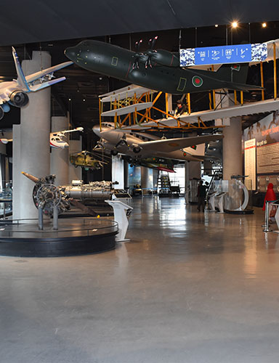
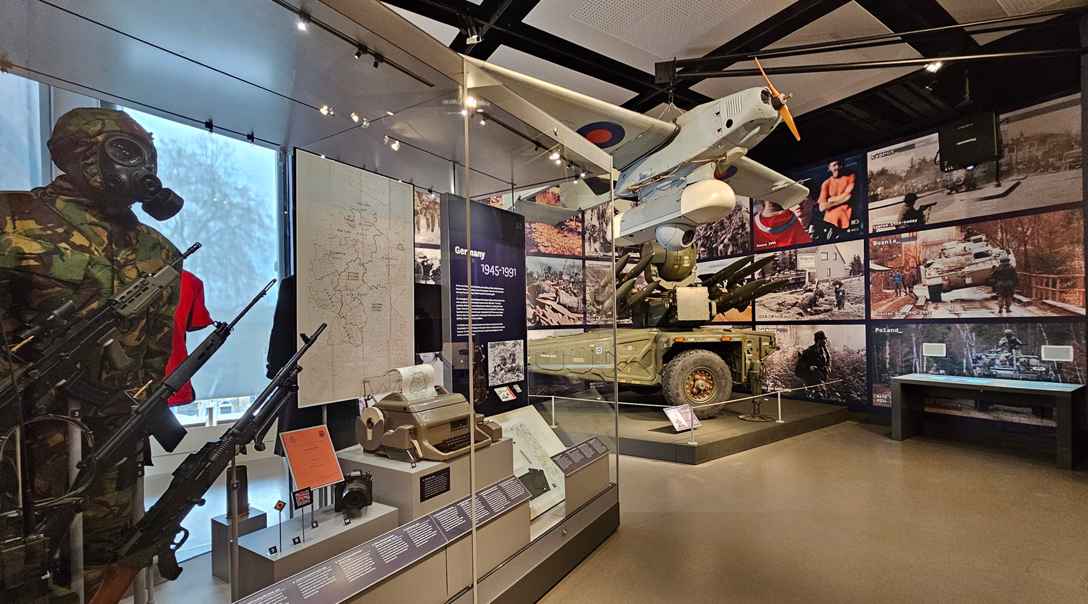
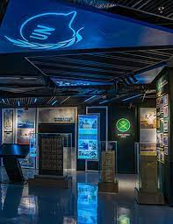
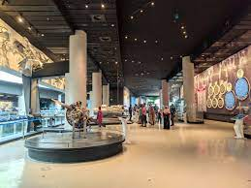
How these institutions adapt themselves with the changing point of view
Museums and cultural clubs adapt their exhibitions and programs by incorporating diverse viewpoints and contemporary interpretations of history and culture. This flexibility allows them to stay relevant and engage with changing societal attitudes and understandings

Slide 9
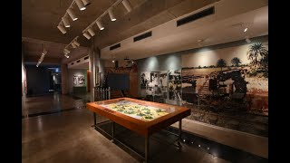
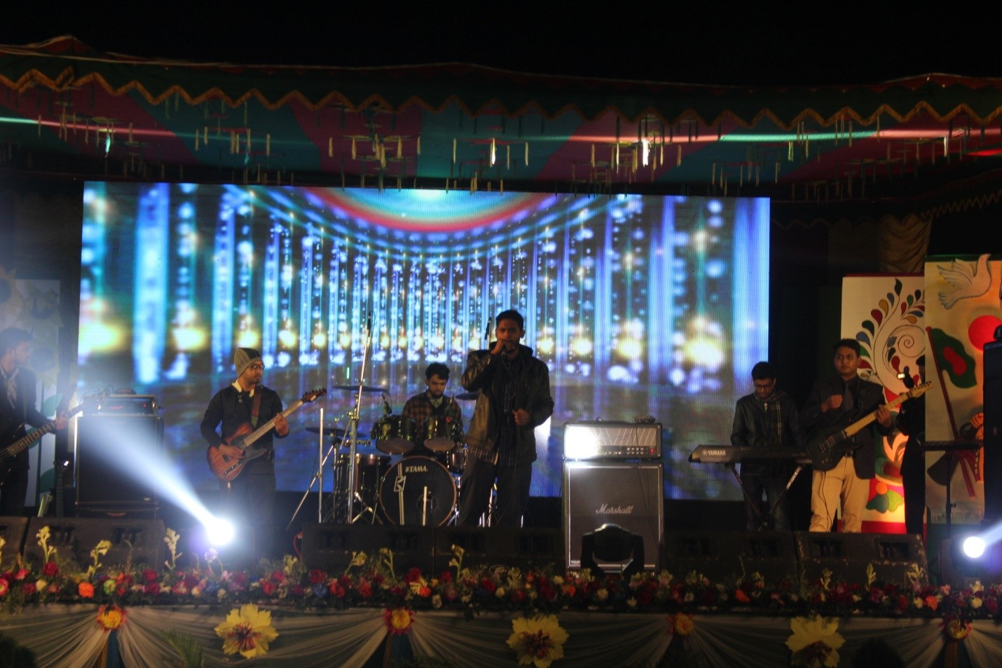
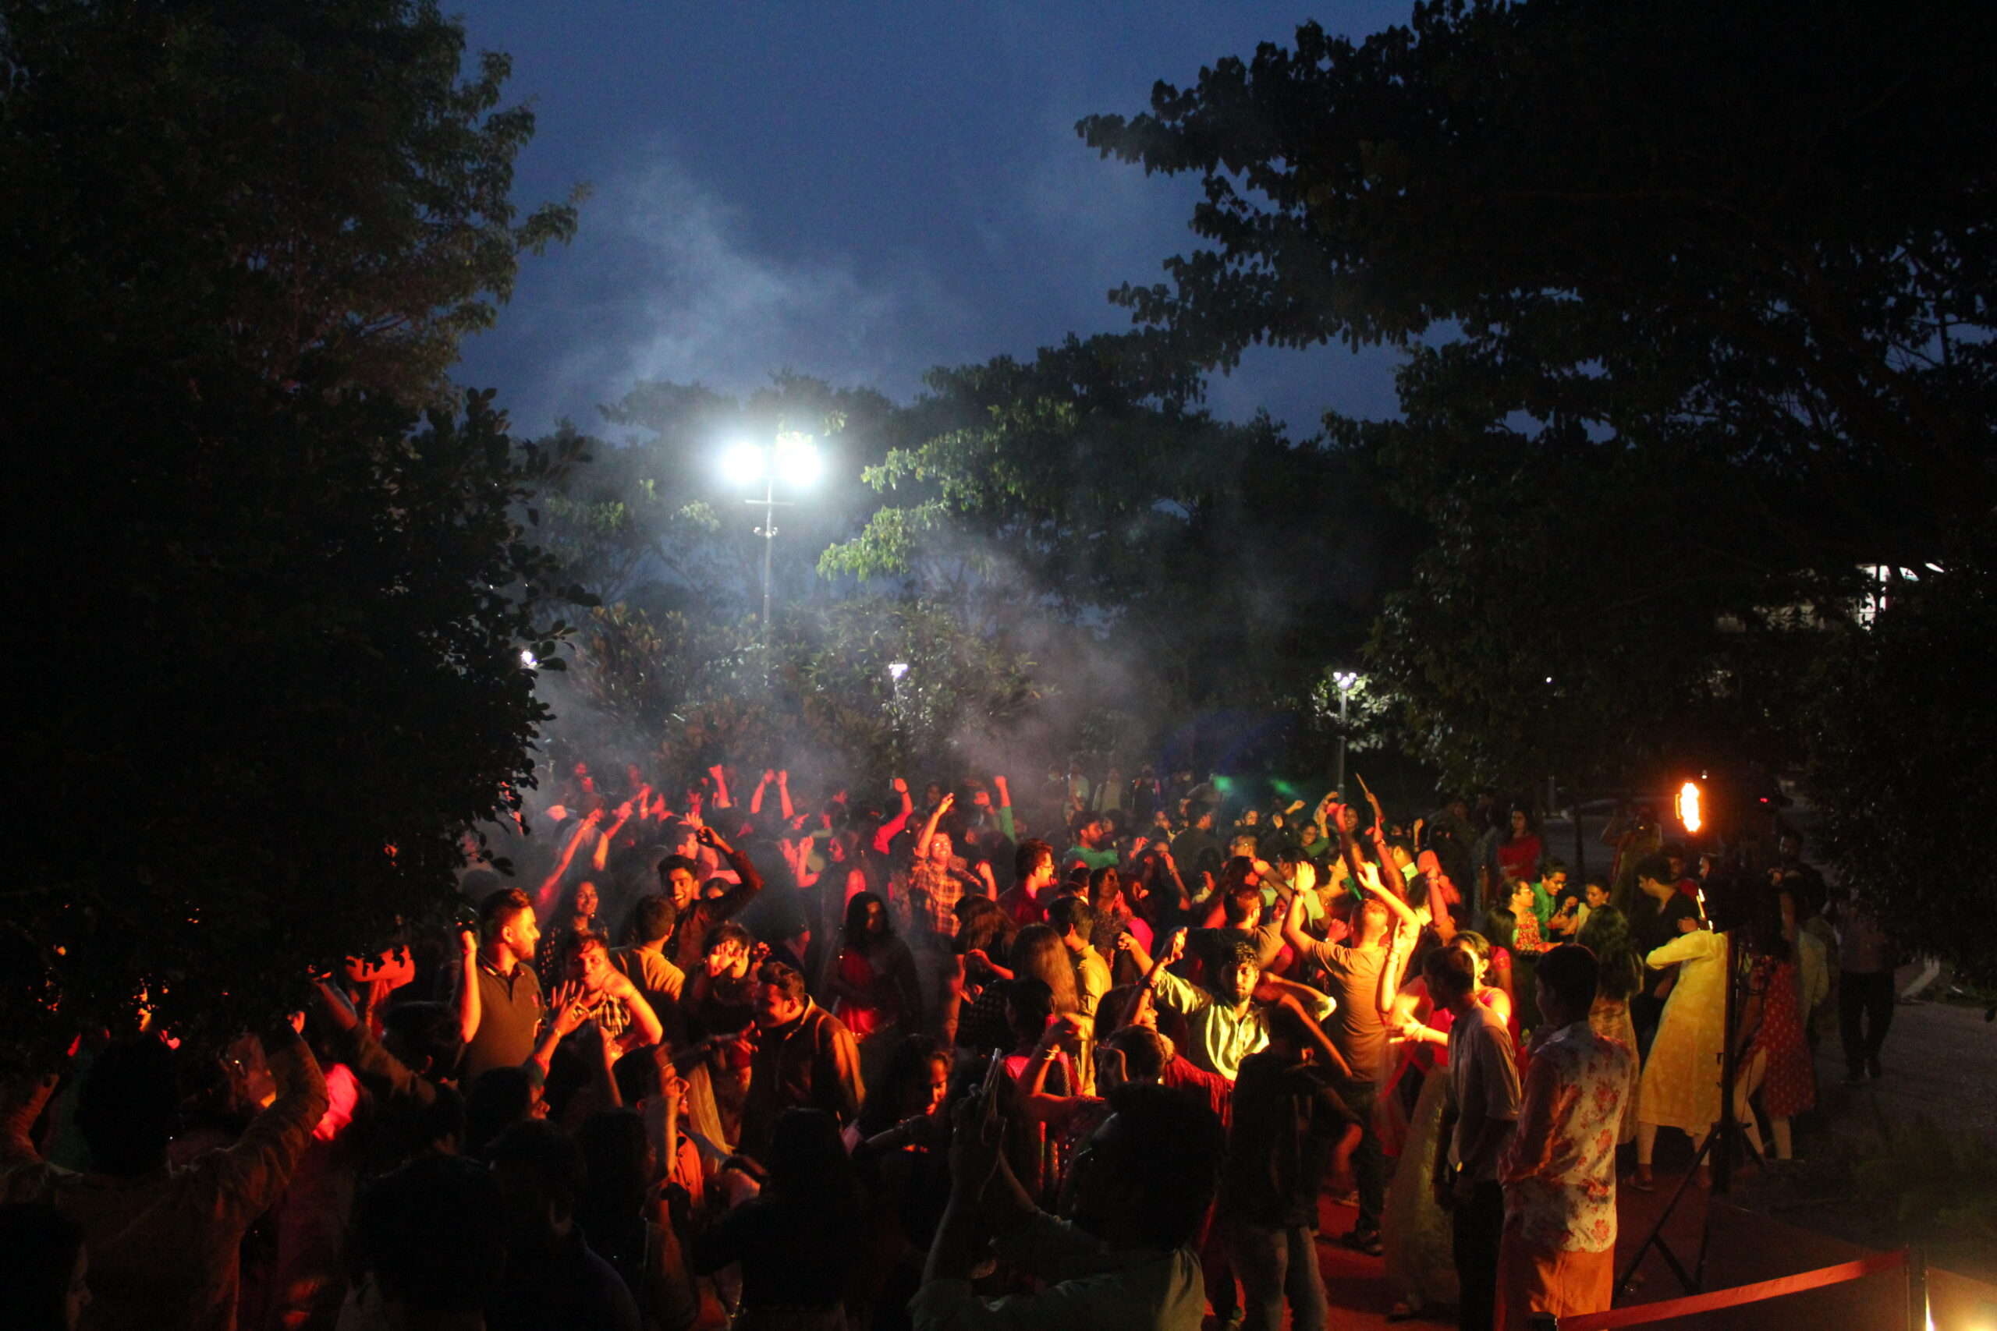
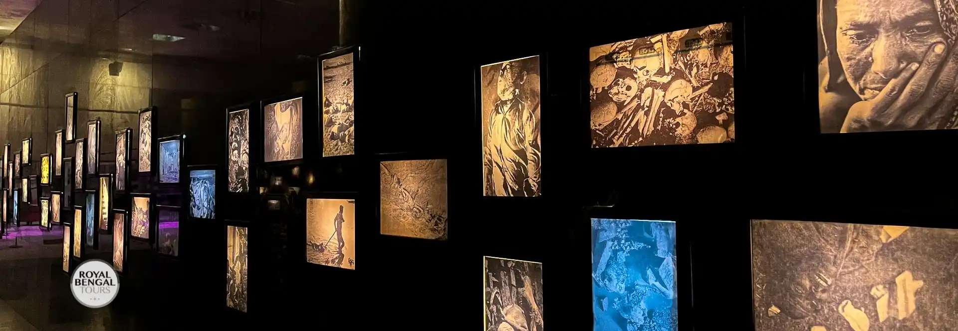
Modification in their activities over time
Over time, the idea of museums and cultural clubs has changed dramatically in response to shifting societal norms and values. In the beginning, museums were frequently exclusive collections of rare and valuable artifacts for the affluent elite. But in the 19th and 20th centuries, museums began to focus more on public accessibility and educational goals, evolving into establishments dedicated to cultural preservation and public education. Similar to this, cultural clubs began as grassroots groups committed to honoring and advancing particular cultural identities. However, throughout time, they have grown to include greater community involvement and inclusivity, reflecting how our view of cultural heritage has changed in an increasingly globalized society.

Slide 10
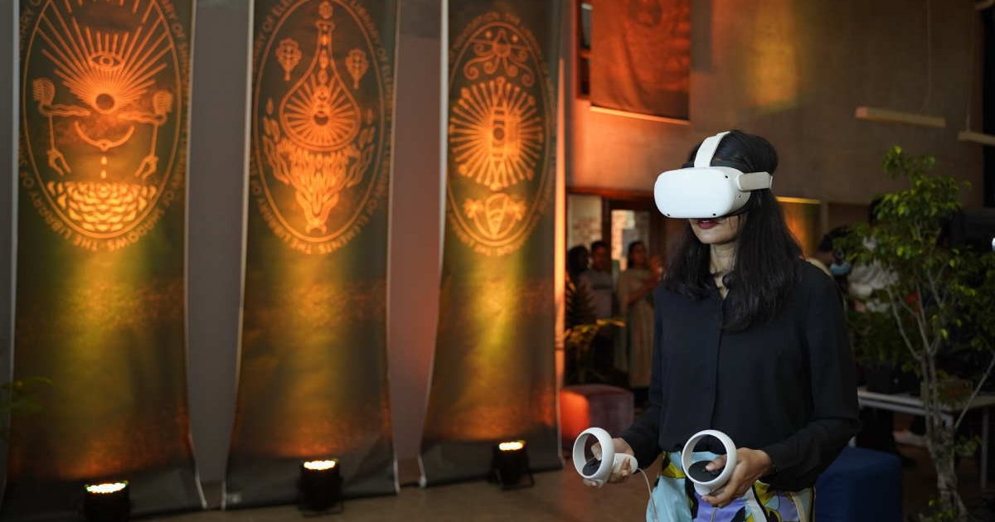
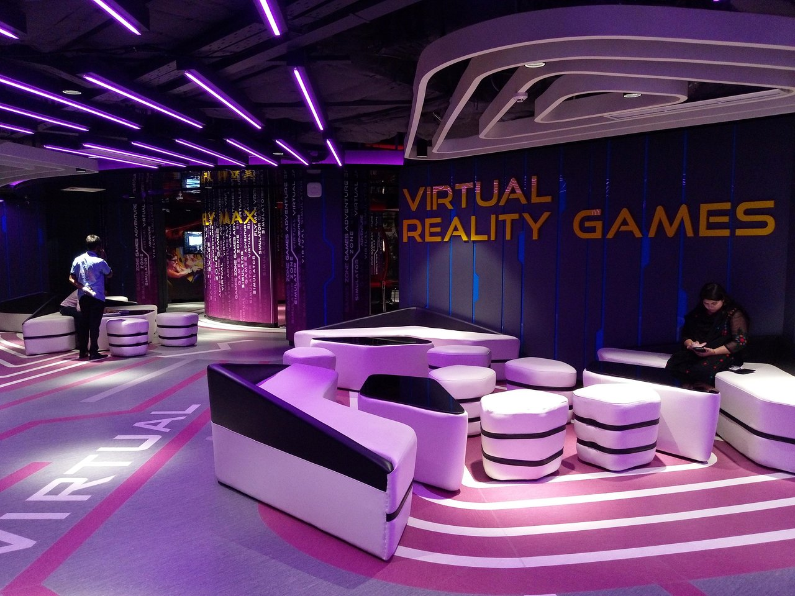
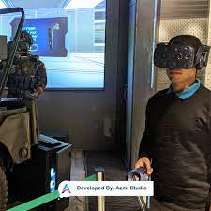
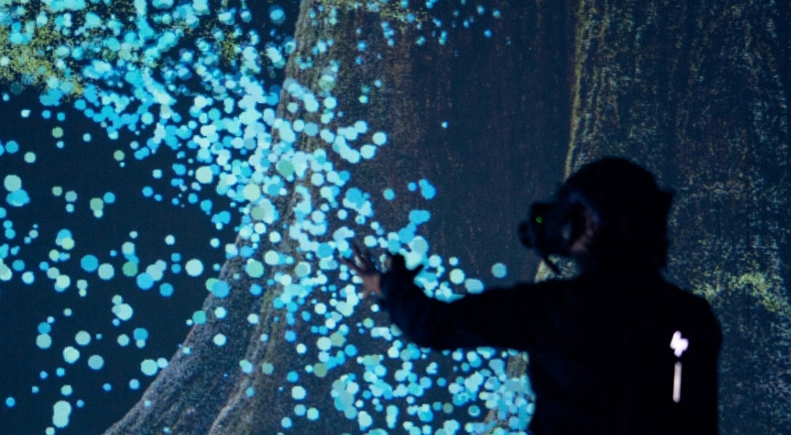
Advancement of these institutions in the age of multimedia & technology
In the age of multimedia and technology, these social elements are also advancing with time. Virtual reality tours, augmented reality displays, and multimedia storytelling platforms are just a few of the immersive and engaging experiences that museums and cultural clubs provide its visitors with by utilizing technology and multimedia. These institutions highlight the universal human experiences that cut over time and space through worldwide partnerships, workshops, and exhibitions. Through the display of trade routes, migration patterns, and cross-cultural influences, they provide visitors with a comprehensive understanding of the ways in which diverse societies have interacted and affected one another over time.

Slide 11
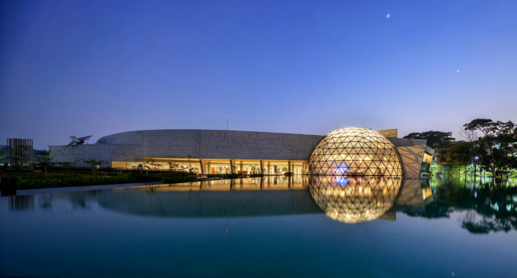
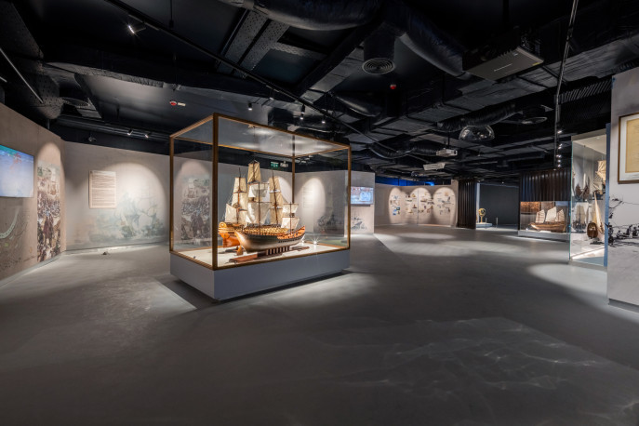
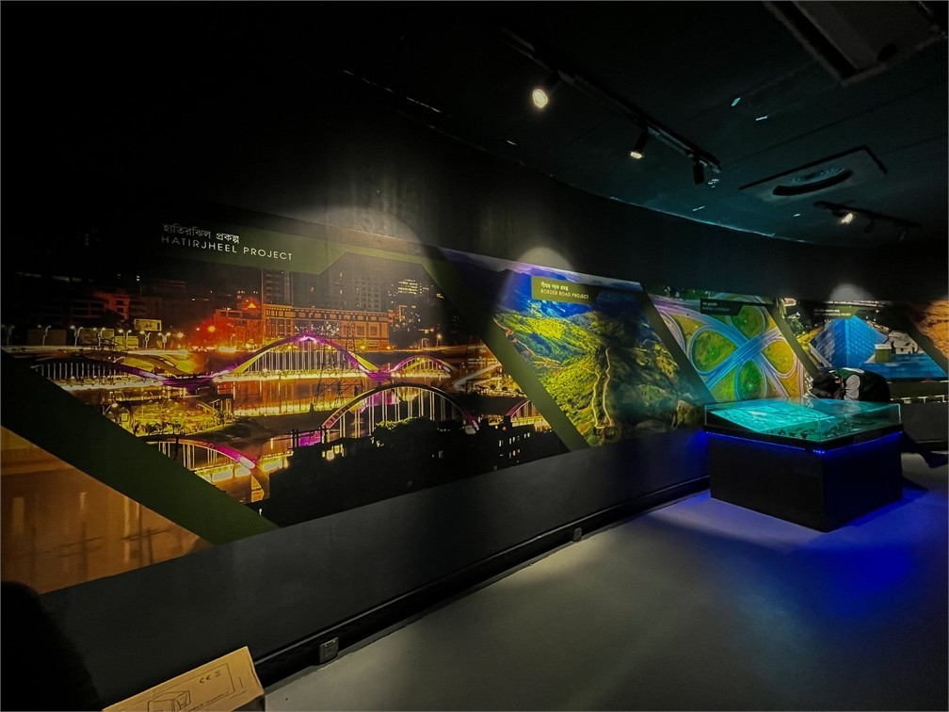
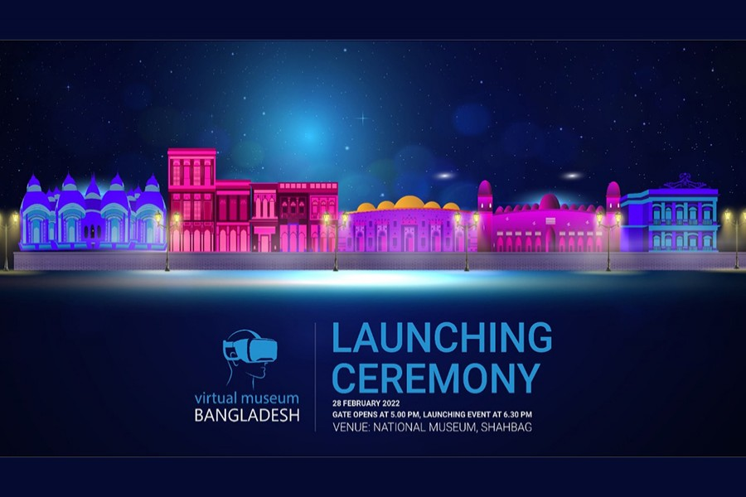
Contribution of museums and cultural clubs in revitalization of endangered languages, traditions, and practices
Museums and cultural clubs often serve as advocates for the preservation and revitalization of endangered languages, traditions, and practices within their communities. Through exhibitions, workshops, and cultural events, they raise awareness about the importance of linguistic and cultural diversity, encouraging community members to actively participate in efforts to safeguard their heritage. By providing platforms for language learning, traditional arts, and intergenerational knowledge exchange, these institutions play a vital role in nurturing pride and continuity in cultural identity.

Slide 12
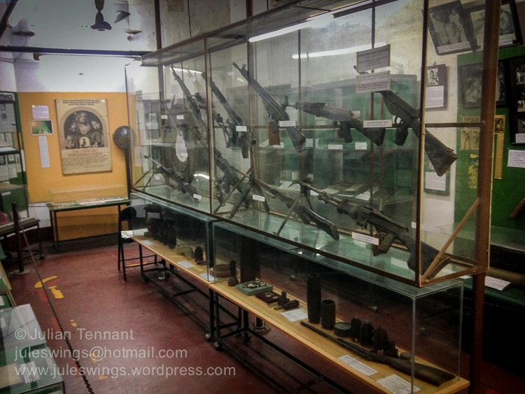
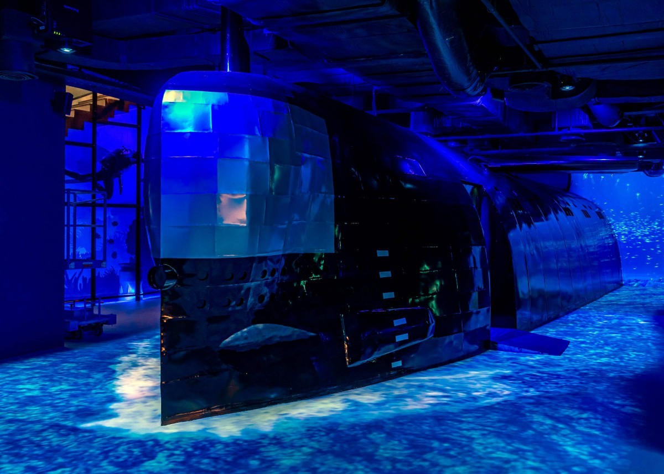
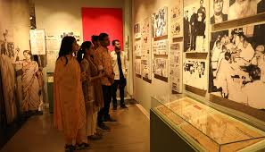
The importance of museums and cultural clubs in social and national life
Museums and cultural clubs serve as important social elements as they-
• Preserves cultural heritage: These institutions protect and maintain artifacts, artworks, documents, and traditions for future generations.
• Provides educational value: They continue to educate the public about history, art, science, and cultural aspects.
• Maintains identity and community pride: Conservation preserves tangible and intangible elements of a community's identity.
• Promotes tourism and economic development: Well-preserved museums attract tourists and contribute to local economies.
• Prevents loss and degradation: Conservation measures prevent deterioration, damage, or loss of artifacts, artworks, and historical sites

Slide 13
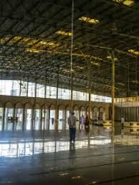
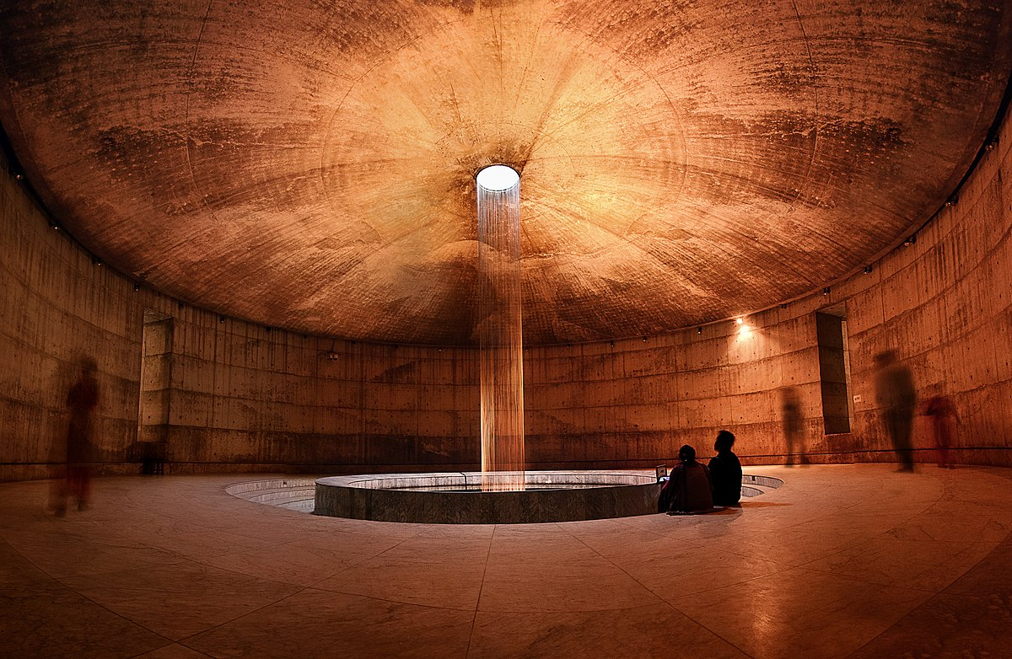
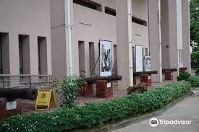
Challenges faced by museums and cultural clubs
Despite of having much importance in many crucial sectors of our national and social life, these institutions face a lot of challenges such as-
• Lack of Funding: Insufficient resources for maintenance, conservation, and expansion of collections.
• Deteriorating Infrastructure: Inadequate buildings, climate control systems, and limited exhibition spaces.
• Declining Public Interest: Decreased public interest in visiting museums and cultural club activities.
• Limited Government Support: Challenges in obtaining consistent support and funding from government agencies.
• Threats to Cultural Heritage: Natural disasters, urban development, pollution, and looting pose significant threats to cultural artifact preservation.

Slide 14
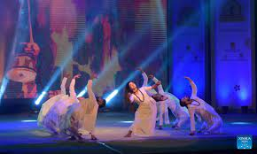
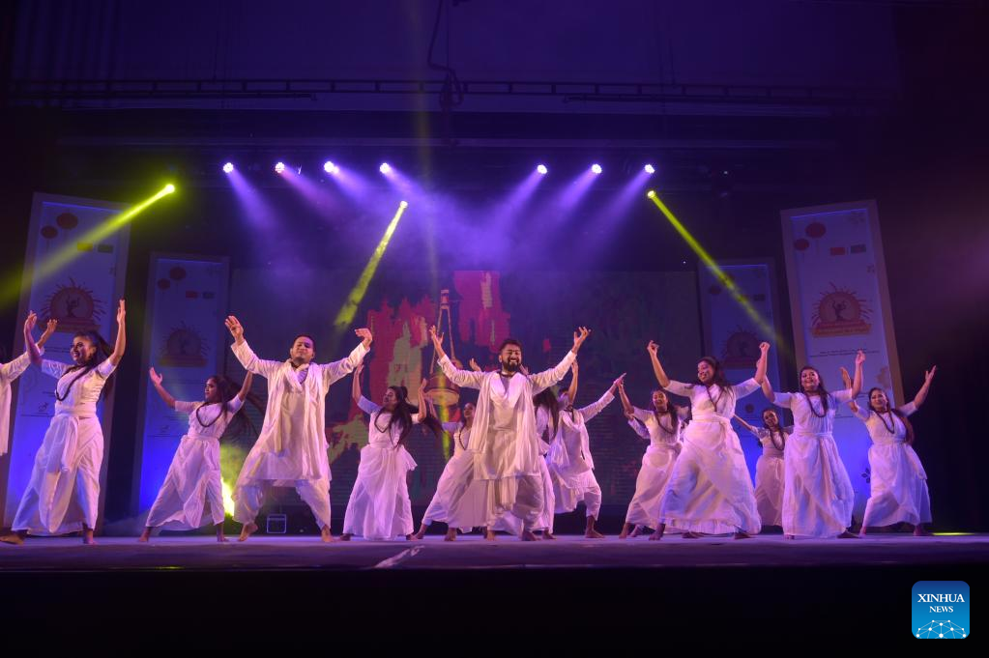
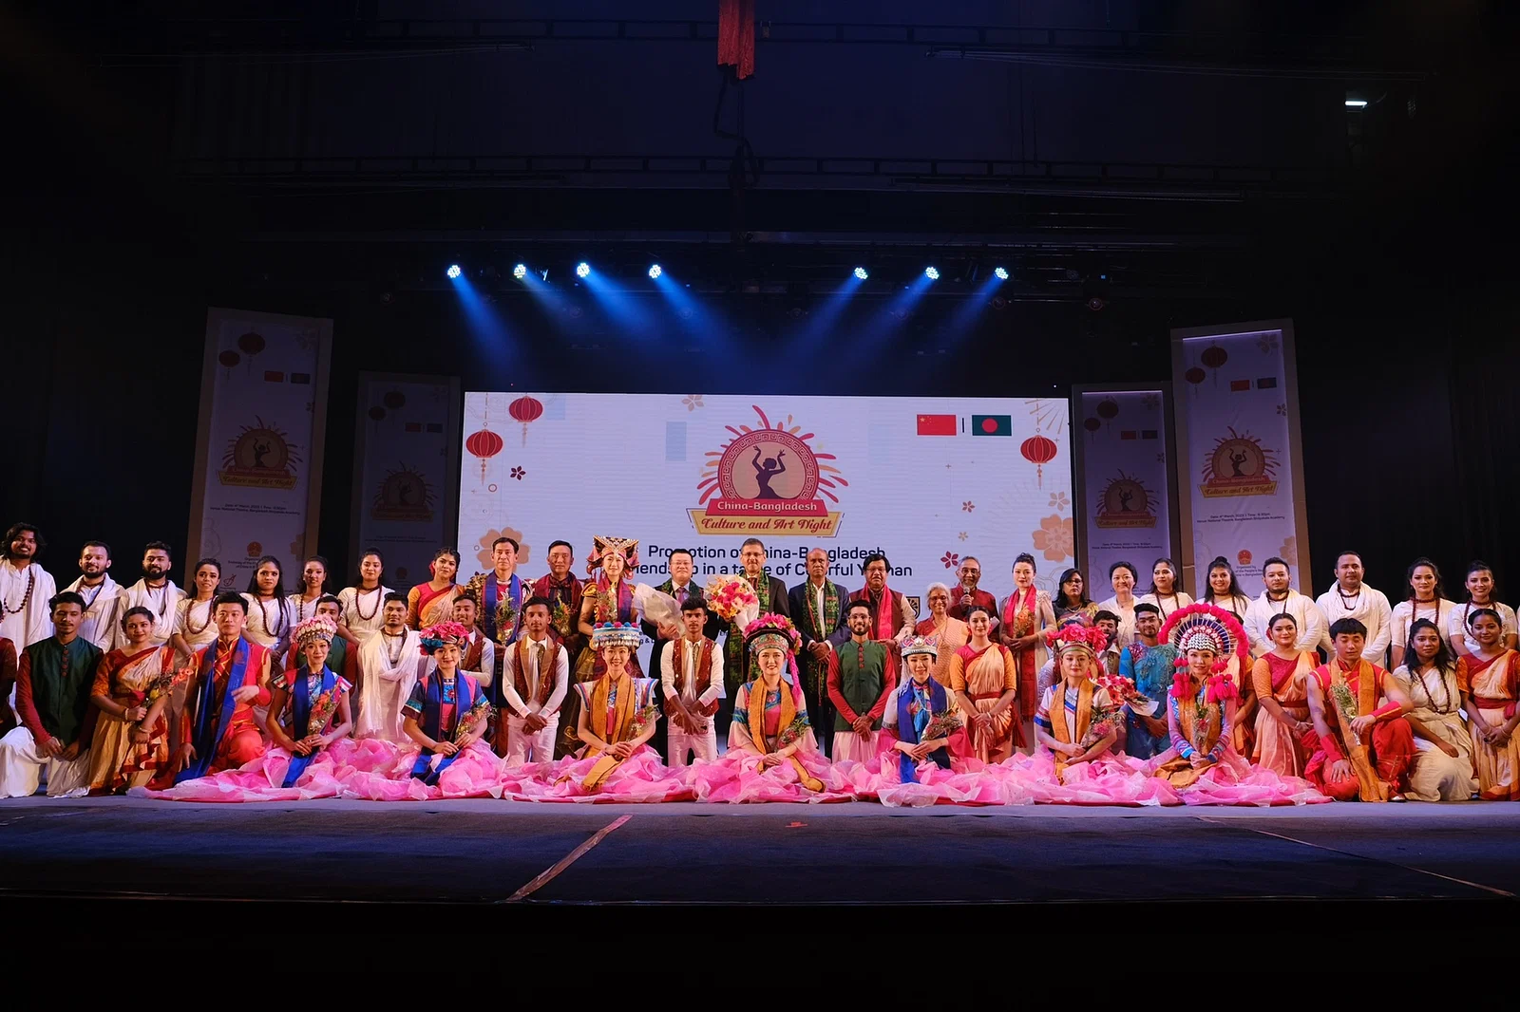
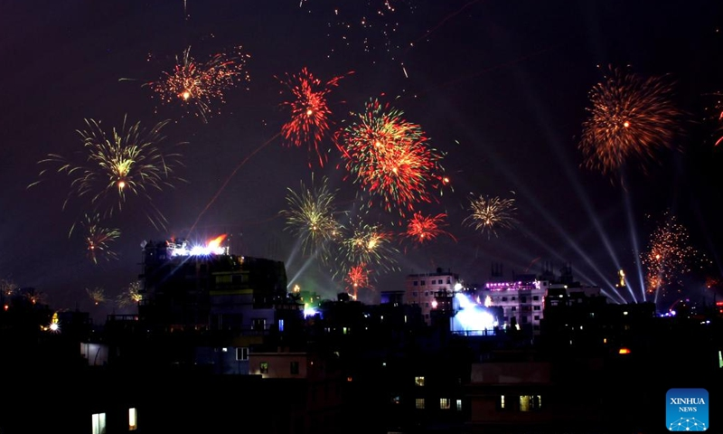
Positive effects of minimizing their degradation
Materializing conservation attempts in museums and cultural clubs can lead to several positive changes:
• Preservation of cultural heritage: Conservation ensures long-term survival of artifacts, artworks, documents, and historical sites.
• Enhanced educational experiences: Well-conserved museums and cultural clubs provide enriching educational experiences.
• Strengthened community ties: Conservation projects engage local communities in preserving and promoting cultural heritage.
• Increased tourism and economic benefits: Well-preserved museums and cultural clubs stimulate economic development through visitor spending and cultural tourism.
• Promotion of cultural diversity: Conservation efforts safeguard heritage of diverse communities, languages, traditions, and practices.
• Support for sustainable development: Sustainable conservation practices minimize environmental impact.
• Advancement of research and scholarship: Conservation projects support scholarly research and academic study.
• Celebration of creativity and innovation: Conserved museums and cultural clubs showcase creativity and innovation.

Slide 15
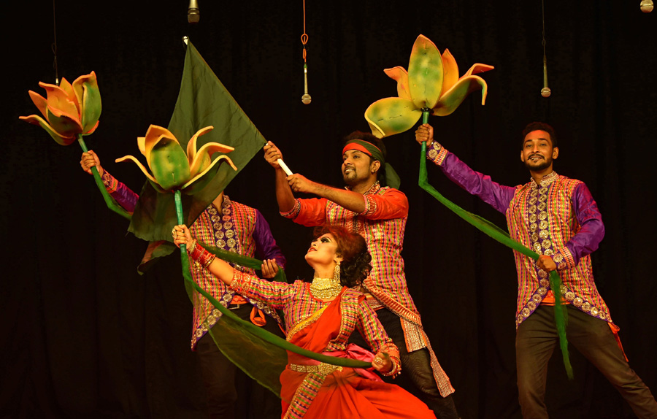
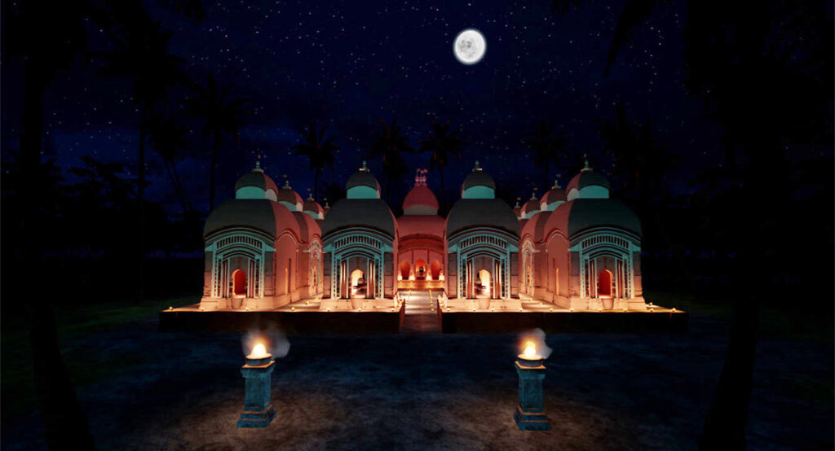
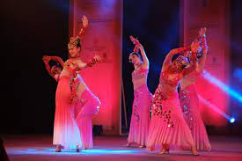
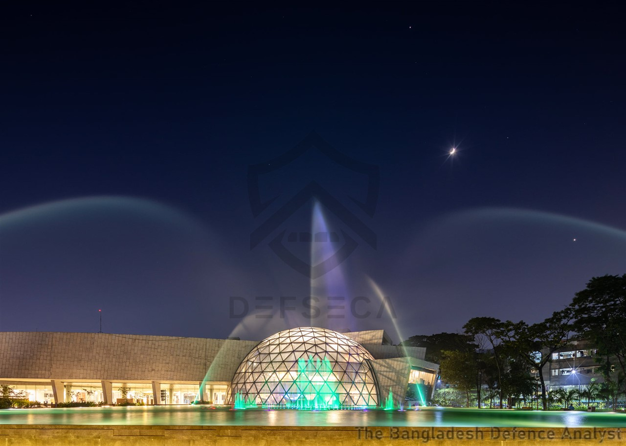
What can happen if we don’t conserve museums and cultural clubs?
If museums and cultural clubs are not conserved, several negative consequences can occur:
• Loss of Cultural Heritage: Without conservation, artifacts, artworks, documents, and historical sites in these institutions risk deterioration, damage, or loss.
• Diminished Educational Opportunities: Without conservation, these institutions may become inaccessible, limiting learning opportunities about heritage, history, and culture.
• Decline in Tourism and Economic Impact: Without conservation, these institutions may lose their appeal to tourists, reducing tourism revenue and economic development opportunities.
• Erosion of Community Identity: Without conservation, these institutions may lose relevance, reducing community identity and cohesion.
• Irreparable Damage to Cultural Resources: Without conservation, cultural artifacts, artworks, and historical sites are susceptible to threats like environmental degradation, vandalism, theft, and neglect, resulting in permanent loss of valuable heritage.

Slide 16
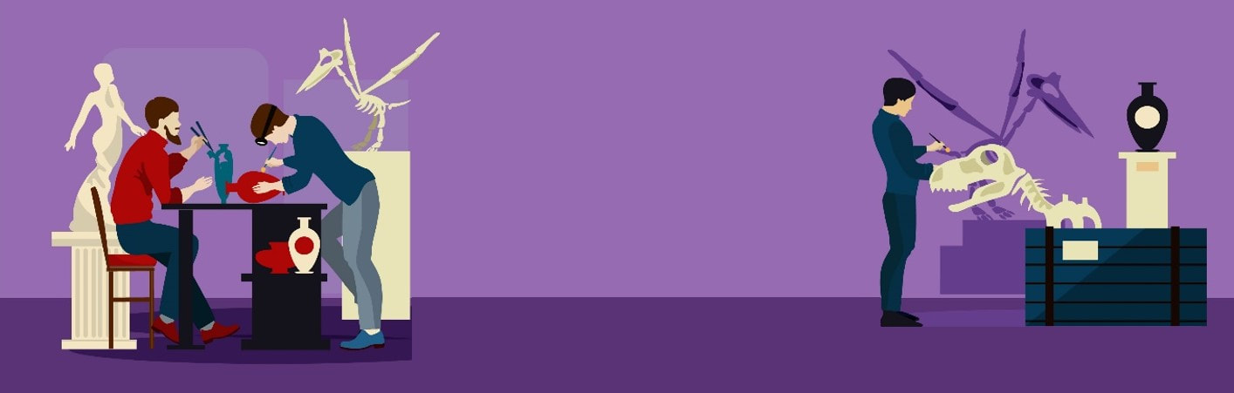
How can we conserve them?

Slide 17
Thank you.
For your meticulous attention. We hope that we could provided you people with
some new information and could raise at least a bit awareness on the fact that we
need museums and cultural clubs for the sake of the next generation and for us.

